Slide 1
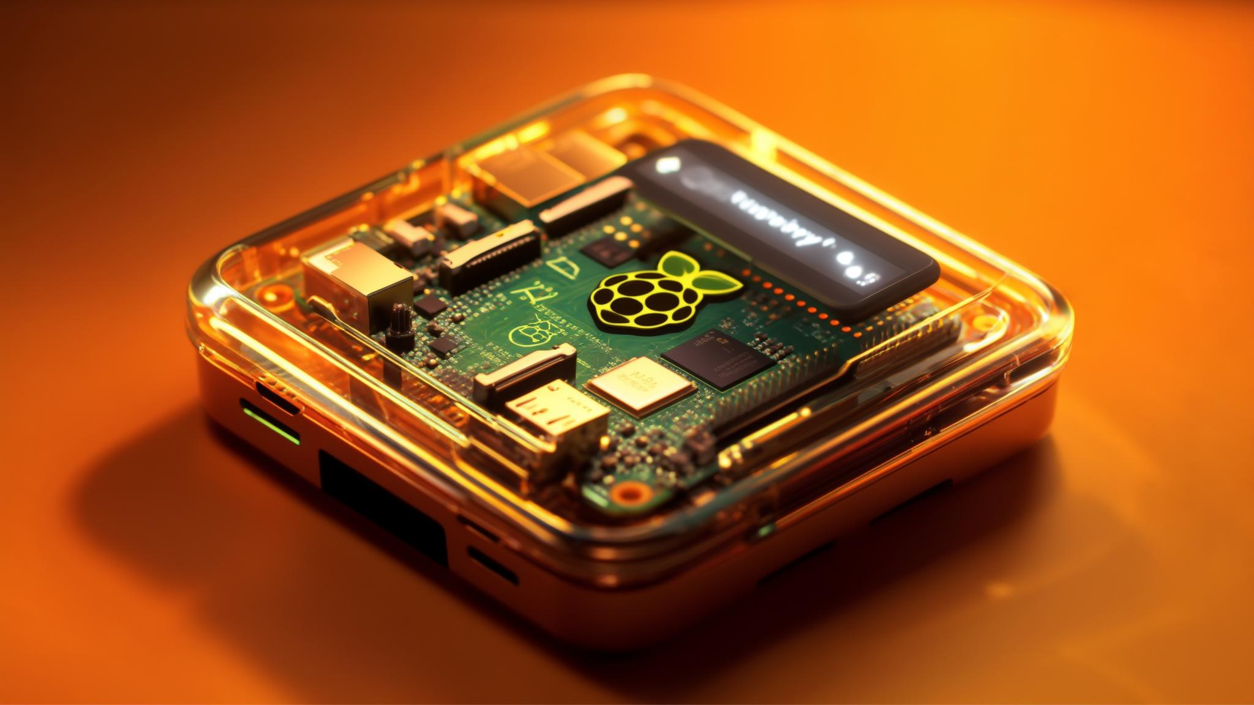
Melro WiFier v1.0
Portable WiFi Penetration Testing Device
Internet of Things
MSc in Cybersecurity - International Hellenic University
Anastasios Istikoglou

Slide 2

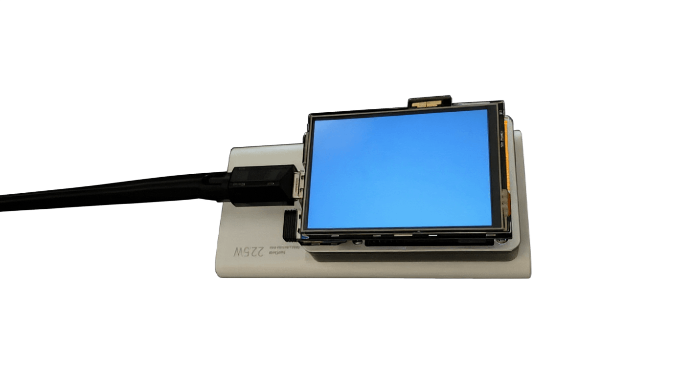
Overview - General Idea
Inspiration
Melro WiFier v1.0 takes its inspiration from the Melro bird, known for its agility and alertness, reflecting the project's core values of mobility, speed, and adaptability. The black-gold color palette draws from the bird’s sleek presence, symbolizing stealth and precision. The idea is also based on a reference to the popular joke that “birds are government surveillance drones,” aligning perfectly with the project’s focus on wireless reconnaissance and offensive testing.
Platform
Built entirely on Kali Linux, Melro WiFier makes use of pre-installed tools, allowing for a plug and play offensive suite. No keyboard, no mouse, just a compact, touch based interface that puts powerful auditing capabilities in the palm of your hand.

Slide 3

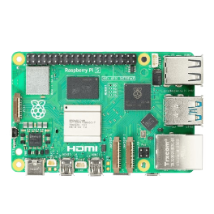



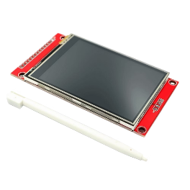

Core Hardware: The Raspberry Pi 5 Foundation
Raspberry Pi 5 (4GB RAM)
Sandisk Extreme Pro 64GB MicroSDXC
EDATEC Passive Cooling Case
Provides the necessary computational power for all funtions and operations.
Storage for the operating system, applications, and captured data.
Ensures quiet passive and efficient thermal management for demanding use.
TP-Link Archer T2U Plus v1
TFT LCD Touch Screen 4"
Huawei Supercharge Power Bank 22.5W
Crucial for its advanced packet monitoring and injection capabilities.
Intuitive control directly on the device, eliminating the need for external peripherals.
Provides approximately 5 hours of continuous operation for extended field use.

Slide 4





Vibe-Coded UI and Attacks Configuration
Python & Tkinter
Real-time Data
Tap To Attack
The user interface is built using Python with the Tkinter library, offering a lightweight and efficient graphical experience perfect for embedded systems.
It provides real-time updates of captured network data, including ESSID, MAC addresses, and signal strength, giving immediate insights into the wireless environment.
Users can easily select attack types, with the easy of a touch making it a simple testing device without any need for configuration.
Both the UI and the attacks configuration were implemented purely by Cursor AI using the Cluade 3.5 model for optimal performance. Its minimalistic approach reduces processing power needs, ensuring smooth operation.

Slide 5

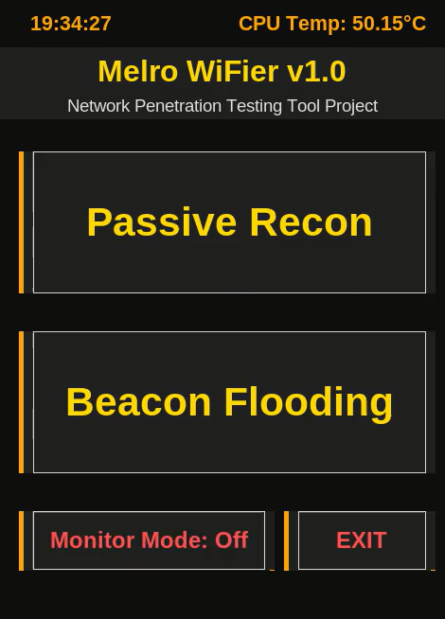
Passive Reconnaissance
The first primary attack capability of Melro WiFier v1.0 is Passive Reconnaissance. This technique involves monitoring WiFi traffic without actively interacting with the network. The device captures various types of packets, identifying addresses of connected devices on the target network. By gathering this data, a clear picture of the network's state is given while some potential targets maybe be identified. This initial phase is vital for understanding the target environment before proceeding with a more active testing.
Monitor WiFi Traffic
Silently observes wireless network activity without detection.

Slide 6

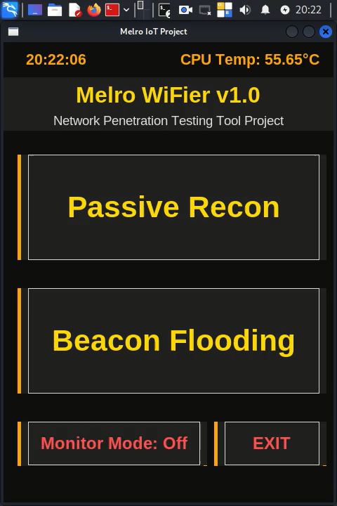
Beacon Flooding
The second attack type implemented in Melro WiFier v1.0 is Beacon Flooding. This capability allows the device to generate multiple fake access points, effectively mimicking legitimate WiFi networks. The purpose of beacon flooding is to lure target devices into attempting to connect to these deceptive access points. This can be used for various purposes, such as identifying potential targets, assessing how devices handle unknown networks, or even for credential harvesting.
Generate Fake Access Points
Creates numerous deceptive WiFi networks.

Slide 7





Limitations and Lessons
Display and UI Scaling on Small Screens
Wireless Adapter Compatibility
Tool Stability and Dependency Conflicts
Resource Constraints and Overheating
Issue: Designing a usable interface on a 4” screen (480x640) is difficult, especially when using only touch input.
Issue: Not all Wi-Fi adapters support monitor mode or packet injection, which are essential for attacks like this.
Issue: Tools like mdk3, mdk4, aircrack-ng, and wifiphisher can have specific OS, driver, or Python version dependencies.
Issue: The Raspberry Pi 5 can get hot quickly, especially during continuous Wi-Fi scanning, attacks, or high CPU usage.
Challenge: Text and buttons may appear too small or too large, requiring constant tweaking of fonts, layouts, and touch zones.
Challenge: Ensuring your adapter supports these features, configuring wlan0mon, and avoiding interference from network managers.
Challenge: Installing and keeping tools functional without breaking others, especially in a lightweight OS environment.
Challenge: Managing temperature and memory usage without active cooling or a full GUI.

Slide 8




Future Improvements
Melro WiFier v1.0 is just the beginning. The vision for future includes expanding its capabilities significantly. There are plans to integrate more advanced attack types, such as Deauthentication attacks and Evil Twin setups, to provide a more comprehensive penetration testing suite. The user interface will be further enhanced with additional features. Furthermore, the aim is to achieve an even smaller form factor, making the device even more portable for covert operations.
More Attack Types
Enhanced UI
Smaller Form Factor
Adding Deauthentication, Evil Twin, and other advanced attacks for comprehensive testing.
Further refining the Python-based interface for additional features.
Optimizing the physical design for increased portability and discretion.

Slide 9
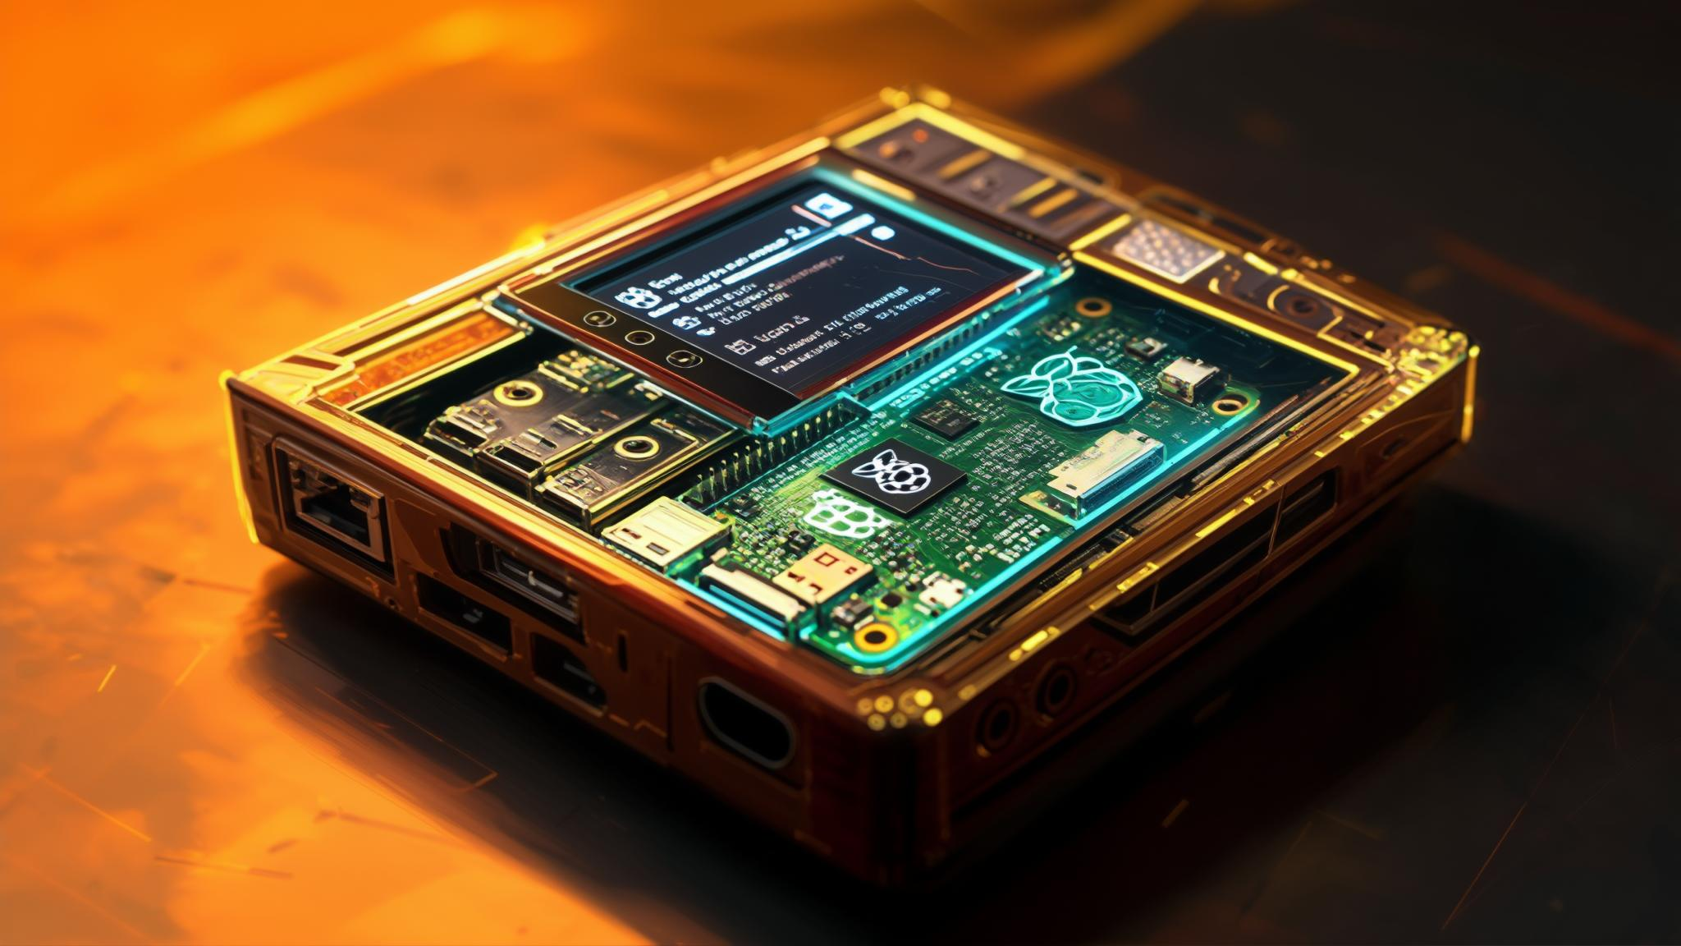

Thank You for Your Attention
I hope this presentation has provided a clear insight into its capabilities and potential for WiFi security assessment. I am open to any questions you may have regarding the hardware, software, attack methodologies, or future development plans of this portable penetration testing device. Feel free to ask anything that comes to mind.

